Slide 1
FETAL PERIOD
Dr. Mbira

Slide 2
From week 9 to birth(9th month).
Characterized by increase in size and complexity of the body organs and organ systems as well as their maturation.
There is rapid increase in size ; both height and weight with weight increase being pronounced in the last 2 months of gestation.
A normal pregnancy lasts 38 weeks or 266 days from fertilization though in routine clinical practice it is calculated as 40 weeks/280 days from the last normal menstrual period(LNMP).
Fetuses born before 36 weeks are said to be premature and those born before 30 weeks are at a high risk of not surviving.

Slide 3
The pregnancy is divided into trimesters of 3 months each.
The 1st trimester is where all the systems are formed, develop and begin to function.
The 2nd trimester is characterized by rapid increase in size of these systems and the body in general. Also the fetus acquires external features resembling those of a newborn which can be seen on imaging studies e.g ultrasound scan.
At the beginning of the 3rd trimester, most of the development has been achieved and a fetus born at this point can survive though with significant difficulty as full maturity is not yet achieved in the organ systems.

Slide 4
Development reaches a landmark at 35 weeks where all the systems have developed enough to enable survival even if the fetus is born prematurely at this point and usually the weight has reached 2.5kgs. This point denotes the fetus achieving maturity and further growth in utero involves chiefly weight gain and accumulation of fat.
About ½ of the birth weight at term is added in the last 2-2 ½ months.

Slide 5
Initially the head occupies almost ½ the size of the fetus at the beginning of the fetal period (beginning of the 3rd month) but with time growth of the head slows down and the rest of the body catches up.
However, even at birth, the head is still one of the most prominent areas in terms of size in the fetus and at birth is the area of the body with the largest circumference.

Slide 6
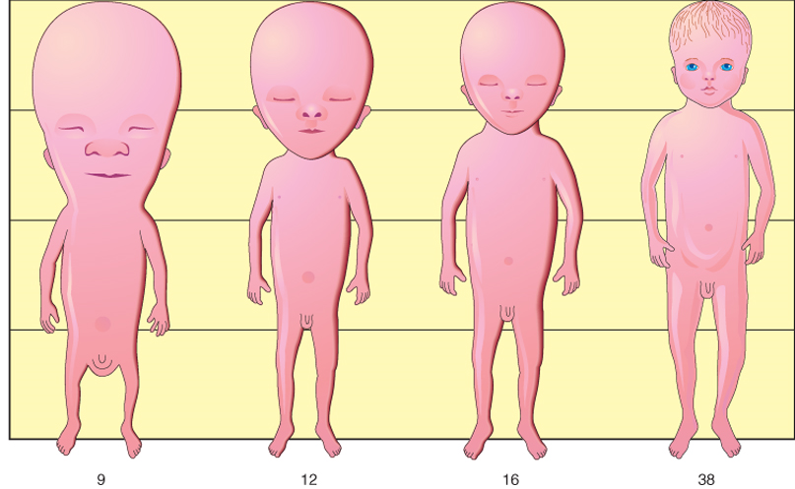
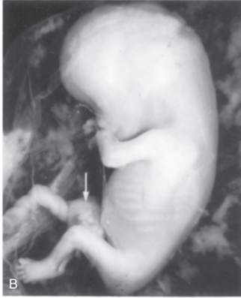

Slide 7
The pregnancy is usually monitored throughout its progress and certain parameters are used to determine if the fetus is growing and/or developing well.
These parameters include:
Length/height/girth
Weight
Physical appearance
Activity of the fetus
The amniotic fluid
During hospital visits, the above indices are noted and compared against the expected values and used as an indicator of normal or abnormal progression of the pregnancy.

Slide 8
Crown-rump length(CRL) or crown-heel length
Head circumference/biparietal diameter
Abdominal circumference
Femur length, foot length
All of the above measurements are used to estimate the weight of the fetus so that at each stage in the pregnancy the growth of the fetus can be recorded and charted.
At delivery; 9 months/38 weeks/40 weeks the fetus is expected to have a weight of 3.4kgs and a height/length of 50cm or 20 inches.

Slide 9
* In utero, due to the confined space, the fetus is normally folded in a knee-chest position thus making it easier to measure the length from the top of the head (vertex/crown) to the sacral region/rump. Crown rump length- CRL is therefore more commonly used than crown heel length.

Slide 10
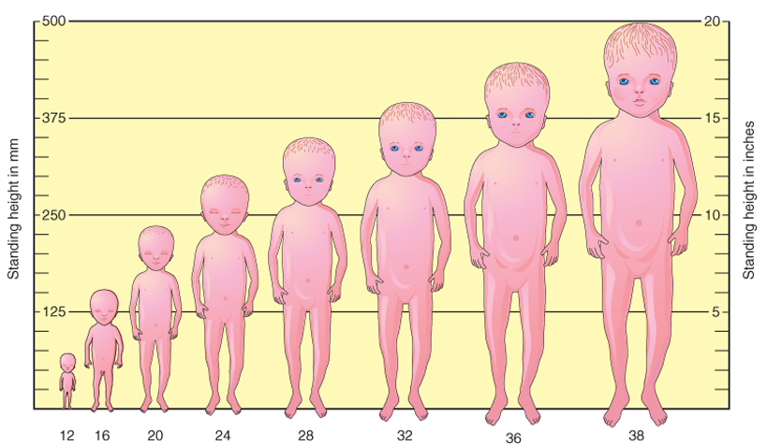

Slide 11
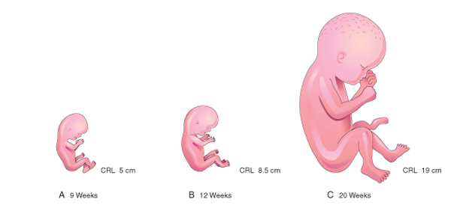
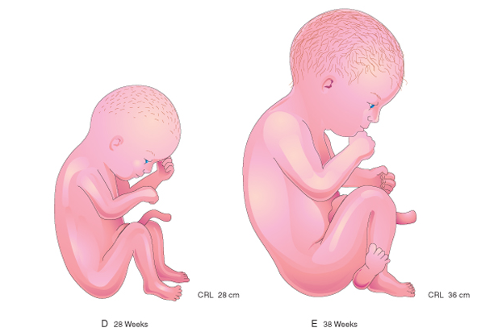

Slide 12
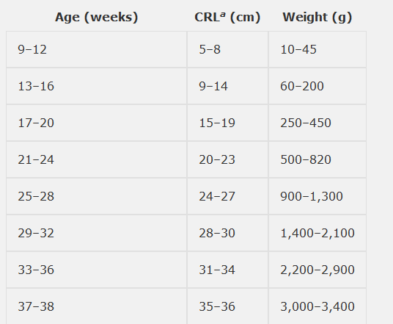

Slide 13
The fetal movements will begin to be felt by the mother at around 18-20 weeks, an event called quickening.
As the fetus develops and acquires a normal human appearance, it is possible to detect developmental anomalies not only on the outward physical appearance but also in the organ systems.

Slide 14
A few highlights
Ossification begins from week 13.
From around week 16, the fetus produces fatty sebaceous secretions from its skin which together with shed cells from the epidermis form a thick protective layer on the skin surface called vernix caseosa.
Also, the fetus grows fine hairs all over the body called lanugo that help to hold the vernix to the skin.
By 18-20 weeks, the internal and external reproductive organs can be seen.
By week 25, the lungs begin producing surfactant.
Between week 26-29, the CNS is able to control breathing, heart rate and regulate body temperature,bone marrow becomes the major site of erythropoiesis, subcutaneous fat increases smoothening out the wrinkled skin, eyelids are open and by week 30 pupils can react to light.

Slide 15
32-34 weeks, there is increase in subcutaneous fat to give the familiar plump appearance of newborns. A neonate born at this time has a high chance of survival despite being premature.
From 36 weeks onwards, the fetus is mature, has a high amount of subcutaneous fat; about 16%, has a weight of around 3.4kgs, a CRL of 36cm and in males the testes are in the scrotum.
However, humans are normally born with some systems such as the nervous system not yet fully developed or mature and thus growth, development and full integration of these systems continues after birth.

